Slide 1
Relational
Algebra
Session 04
Rico Halim, S.Kom., M.Kom.

Slide 2
Learning Outcomes
Session 4
At the end of this session, students will be able to:
LO 2: Explain the concepts of relational algebra, data manipulation language, and transaction management on database

Slide 3
outline
Session 4
Why Relational Algebra?
Unary Operations (SELECT, PROJECT, RENAME)
JOIN Operations (Theta Join, Equijoin, Natural Join)
Set Operations (UNION, INTERSECTION, SET DIFFERENCE, CARTESIAN PRODUCT)
DIVISION

Slide 4
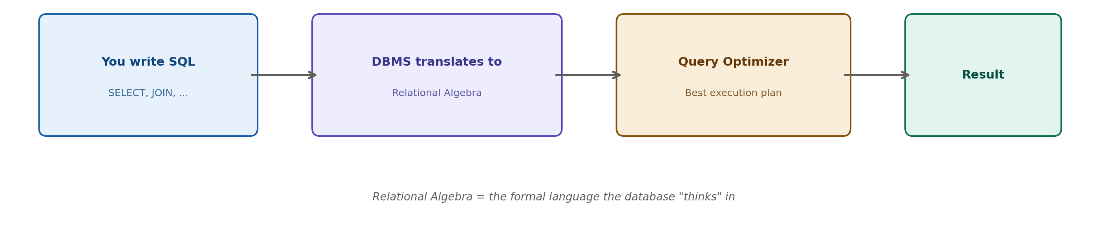
What is Relational Algebra?
A formal language that defines a set of operations to manipulate relations (tables)
Provides the theoretical foundation for SQL — every SQL query you write is internally translated into relational algebra by the DBMS
Analogy: SQL is what you write, Relational Algebra is how the database "thinks"
The query optimizer uses relational algebra to find the most efficient way to execute your query

Slide 5
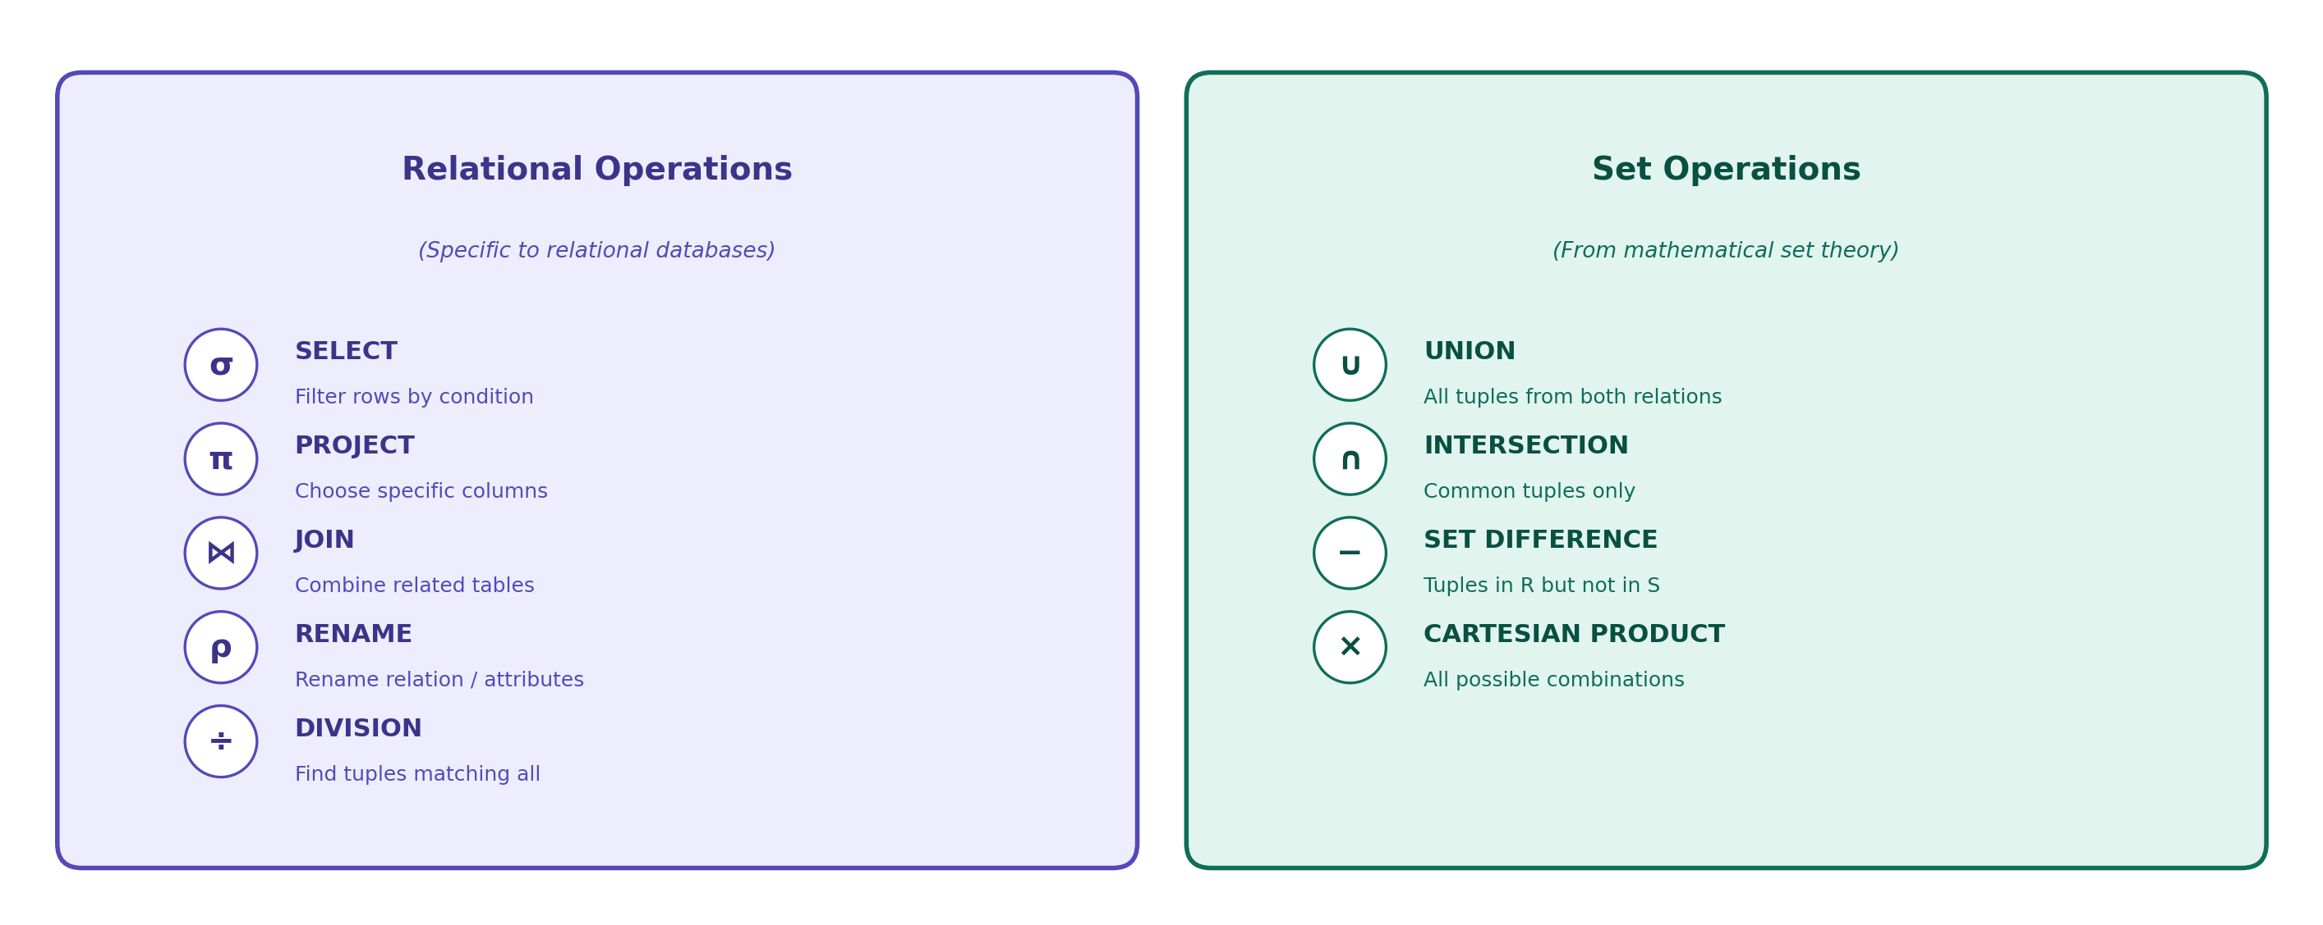
What is Relational Algebra?
Two Groups of Operations

Slide 6
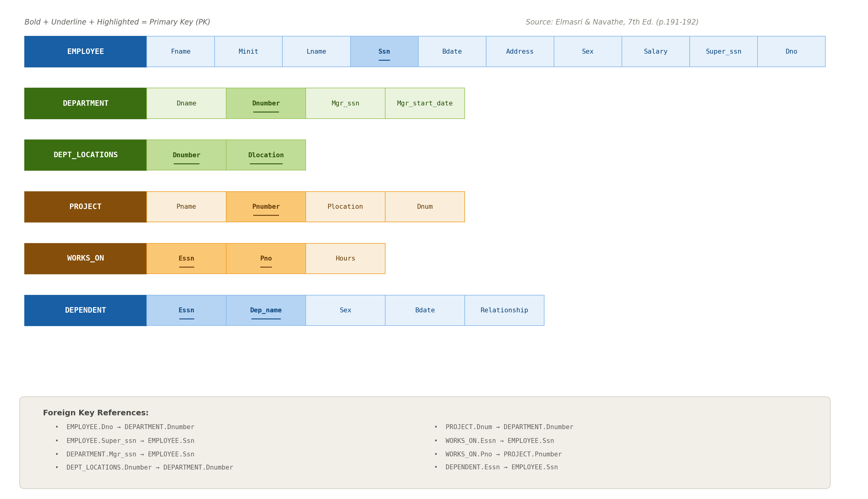
Company Database

Slide 7
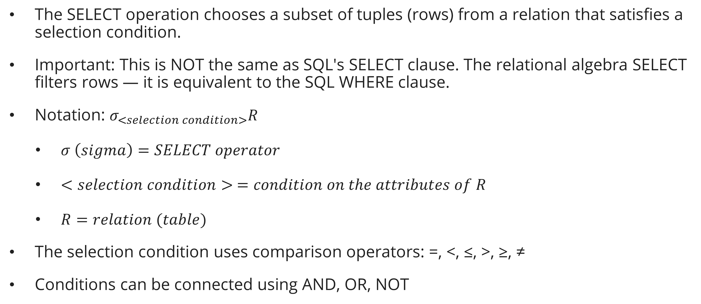
Unary Operations
SELECT Operation ($σ$)
The SELECT operation chooses a subset of tuples (rows) from a relation that satisfies a selection condition.
Important: This is NOT the same as SQL's SELECT clause. The relational algebra SELECT filters rows — it is equivalent to the SQL WHERE clause.
Notation: $σ_{<selection condition>}R$
  $σ \left(sigma\right)=SELECT operator$
  $<selection condition> =condition on the attributes of R$
  $R=relation (table)$
The selection condition uses comparison operators: =, <, ≤, >, ≥, ≠
Conditions can be connected using AND, OR, NOT

Slide 8

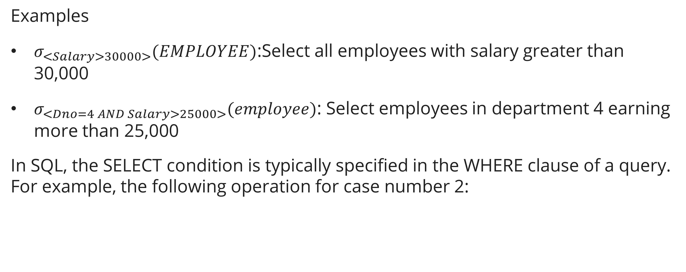
Unary Operations
SELECT Operation ($σ$)
Examples
$σ_{<Salary>30000>}(EMPLOYEE)$:Select all employees with salary greater than 30,000
$σ_{<Dno=4 AND Salary>25000>}(employee)$: Select employees in department 4 earning more than 25,000
In SQL, the SELECT condition is typically specified in the WHERE clause of a query. For example, the following operation for case number 2:

Slide 9
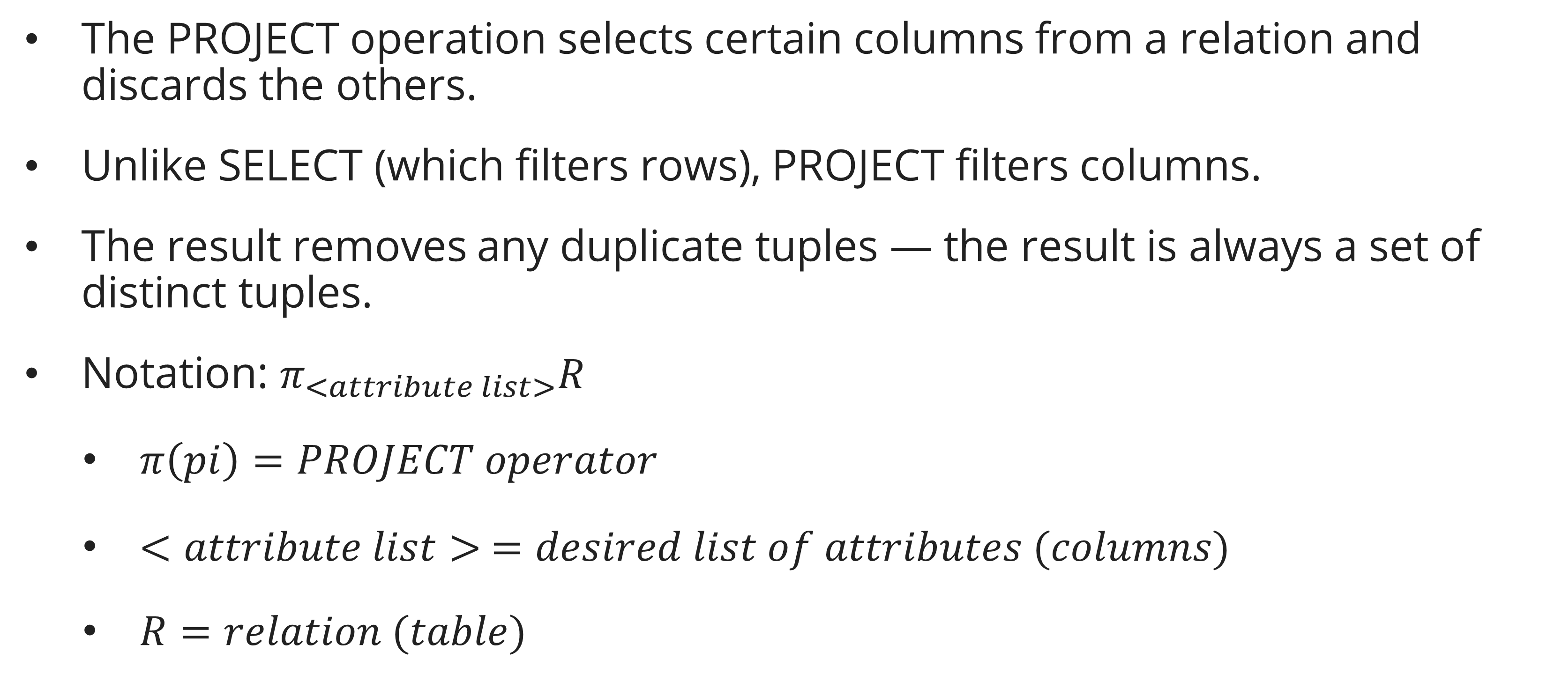
Unary Operations
Project Operation ($π$)
The PROJECT operation selects certain columns from a relation and discards the others.
Unlike SELECT (which filters rows), PROJECT filters columns.
The result removes any duplicate tuples — the result is always a set of distinct tuples.
Notation: $π_{<attribute list>}R$
  $π\left(pi\right)=PROJECT operator$
  $<attribute list> =desired list of attributes (columns)$
  $R=relation (table)$

Slide 10
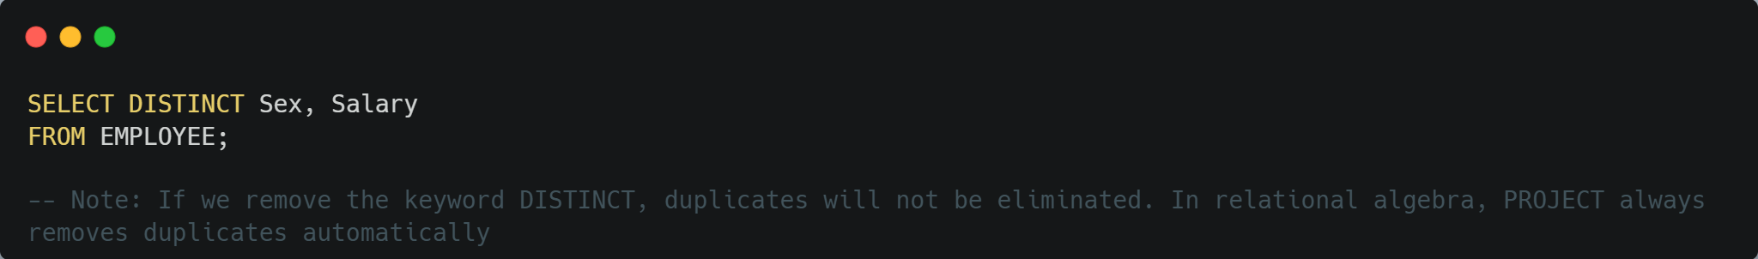
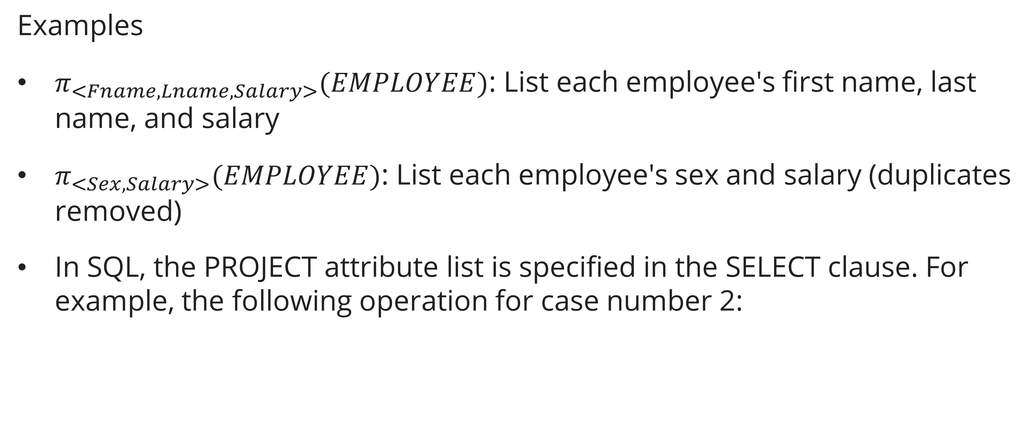
Unary Operations
Project Operation ($π$)
Examples
$π_{<Fname, Lname, Salary>}(EMPLOYEE)$: List each employee's first name, last name, and salary
$π_{<Sex, Salary>}(EMPLOYEE)$: List each employee's sex and salary (duplicates removed)
In SQL, the PROJECT attribute list is specified in the SELECT clause. For example, the following operation for case number 2:

Slide 11

Unary Operations
Sequence of Operations
We can combine SELECT and PROJECT into a single expression. To retrieve the first name, last name, and salary of employees in department 5:
$$π_{<Fname, Lname, Salary>}(σ_{Dno=5}(EMPLOYEE))$$
This reads from inside out: first SELECT (filter rows), then PROJECT (choose columns).

Slide 12
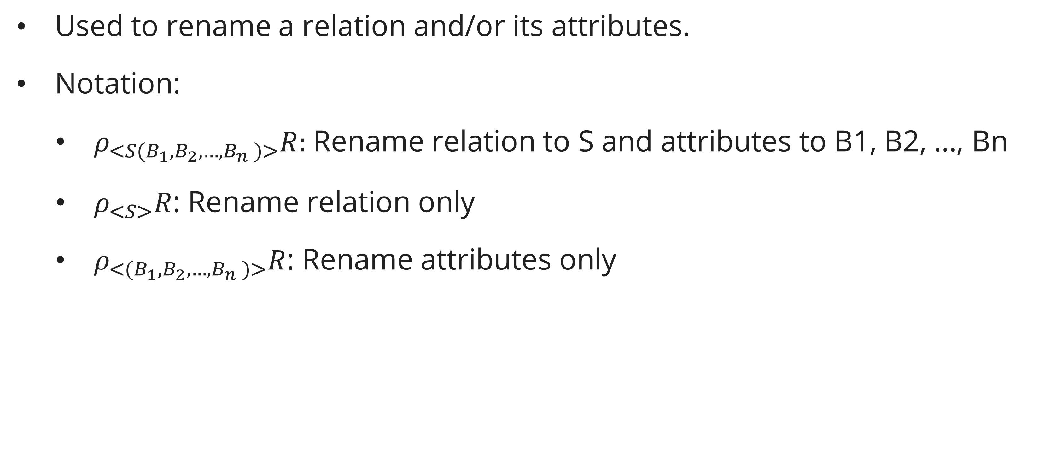
Unary Operations
RENAME ($ρ$)
Used to rename a relation and/or its attributes.
Notation:
  $ρ_{<S(B_{1},B_{2},{…,B}_{n})>}R:$Rename relation to S and attributes to B1, B2, ..., Bn
  $ρ_{<S>}R$: Rename relation only
  $ρ_{<(B_{1},B_{2},{…,B}_{n})>}R$: Rename attributes only

Slide 13
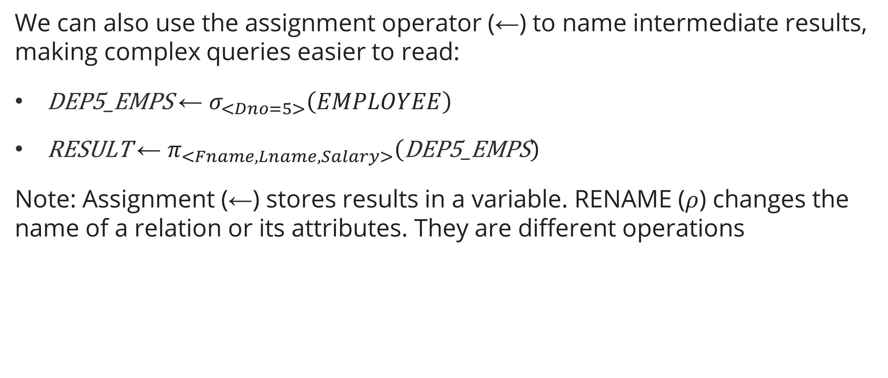
Unary Operations
RENAME ($ρ$)
We can also use the assignment operator (←) to name intermediate results, making complex queries easier to read:
$\text{D}\text{EP}\text{5_}\text{EMPS} \text{←} σ_{<Dno=5>}\left(EMPLOYEE\right)$
$\text{RESULT} \text{← }π_{<Fname,Lname,Salary>}\left(\text{DEP}\text{5_}\text{EMPS}\right)$
Note: Assignment (←) stores results in a variable. RENAME ($ρ$) changes the name of a relation or its attributes. They are different operations

Slide 14
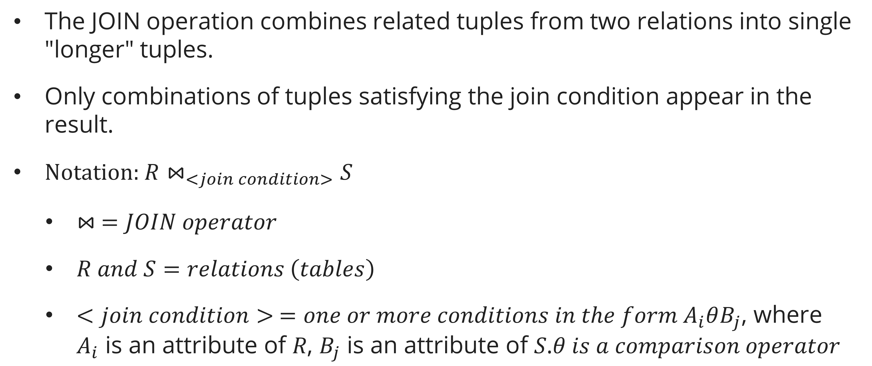
JOIN Operations
JOIN Operation ($⋈$)
The JOIN operation combines related tuples from two relations into single "longer" tuples.
Only combinations of tuples satisfying the join condition appear in the result.
Notation: ${R⋈}_{<join condition>}S$
  $⋈ =JOIN operator$
  $R and S=relations \left(tables\right)$
  $<join condition> =one or more conditions in the form{ A}_{i}θB_{j}\text{, }\text{where} A_{i} \text{is} \text{an} \text{attribute} \text{of} R\text{, }B_{j} \text{is} \text{an} \text{attribute} \text{of} S\text{.} θ is a comparison operator$

Slide 15

JOIN Operations
Theta join
The most general form of JOIN.
The join condition can use any comparison operator: =, <, ≤, >, ≥, ≠
Each condition is of the form: $A_{<i>}θB_{<j>}$, where $A_{<i>}$ is an attribute of $R$, $B_{<i>}$ is an attribute of $S$.

Slide 16
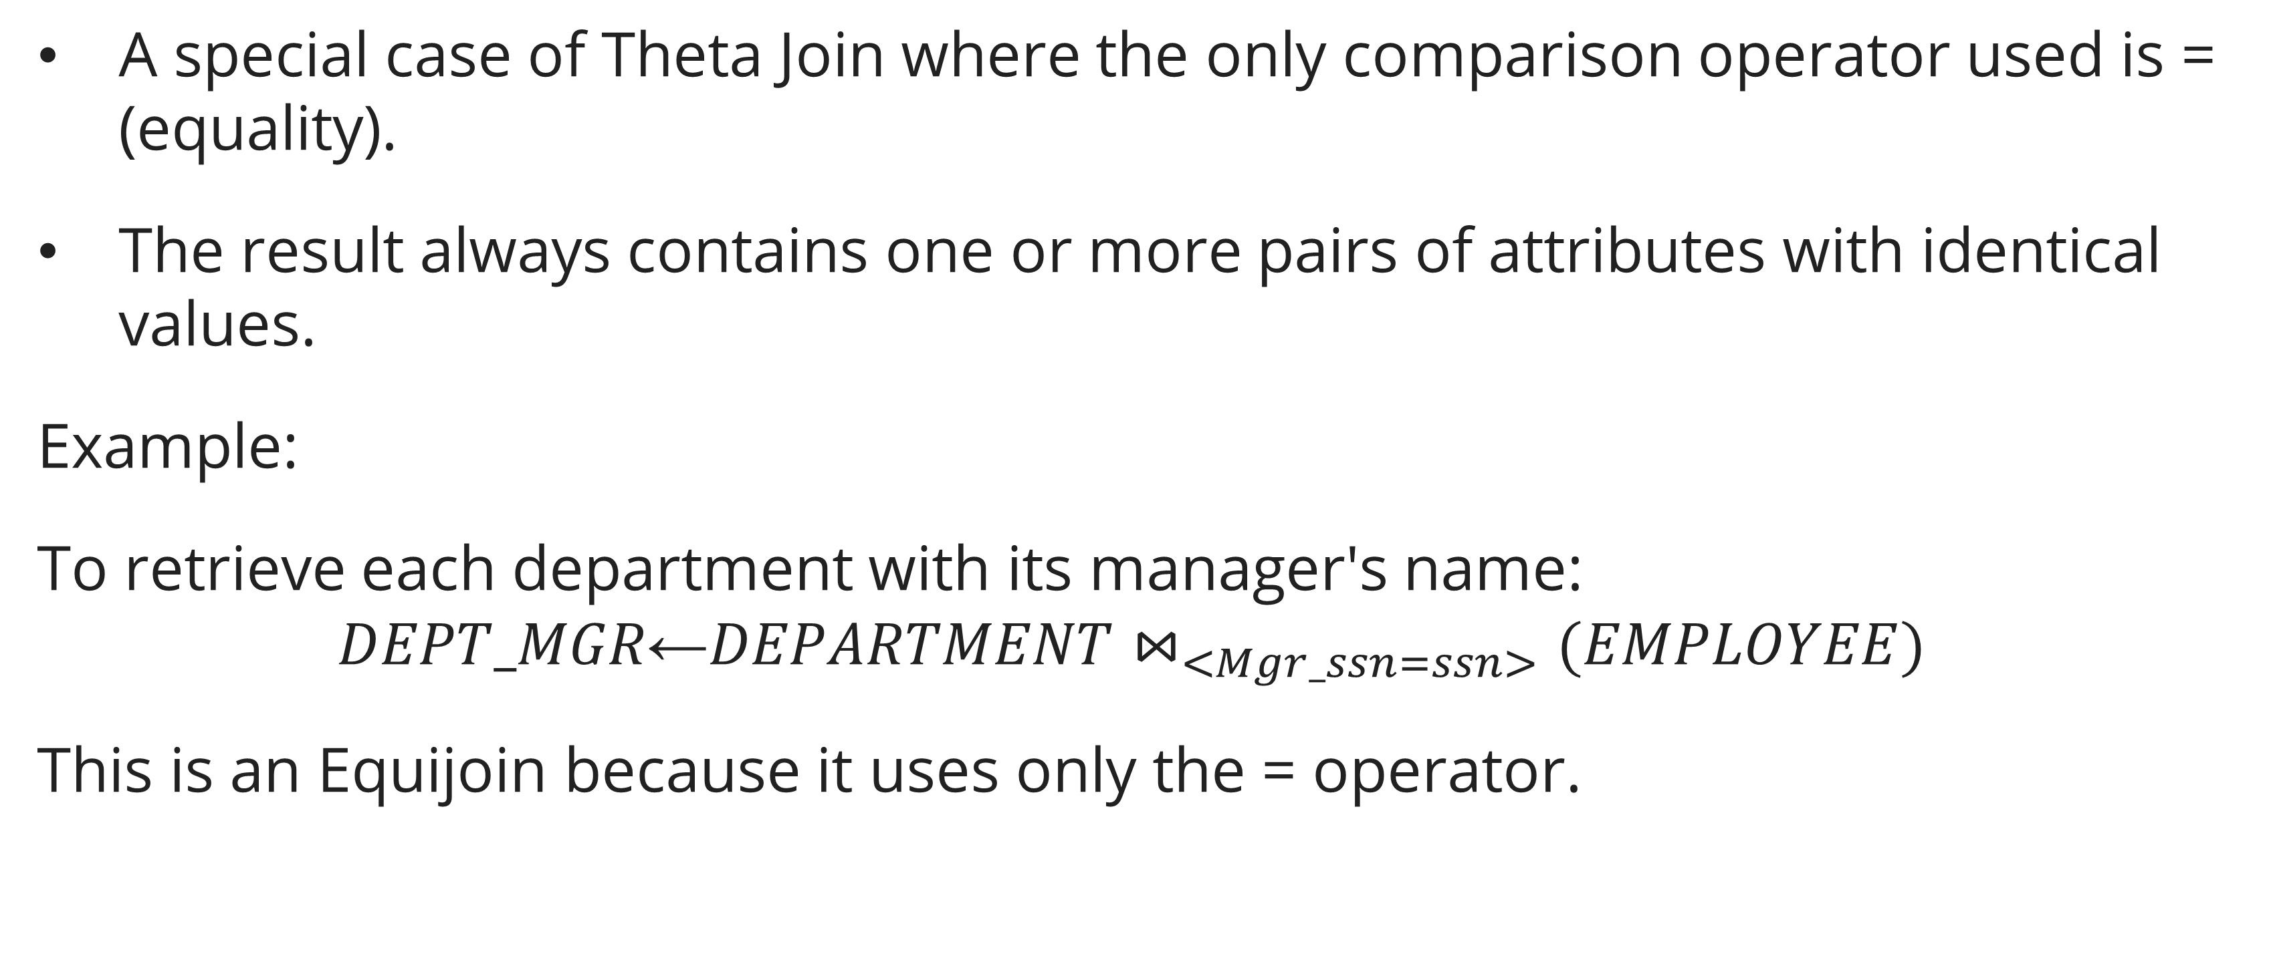
JOIN Operations
Equijoin
A special case of Theta Join where the only comparison operator used is = (equality).
The result always contains one or more pairs of attributes with identical values.
Example:
To retrieve each department with its manager's name:
$$DEPT_MGR\text{←}DEPARTMENT⋈_{<Mgr_ssn=ssn>}(EMPLOYEE)$$
This is an Equijoin because it uses only the = operator.

Slide 17
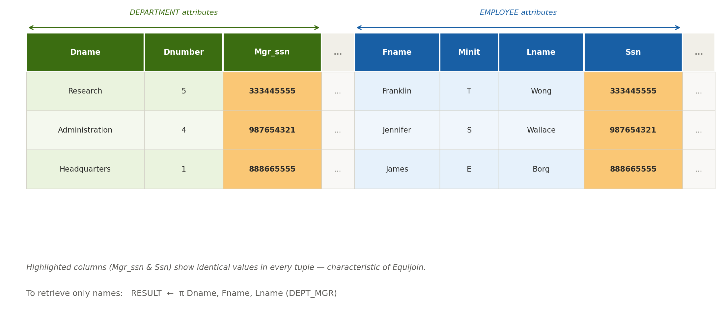

JOIN Operations
Equijoin Result Example
$$DEPT_MGR\text{←}DEPARTMENT⋈_{<Mgr_ssn=ssn>}(EMPLOYEE)$$
Result (DEPT_MGR):

Slide 18
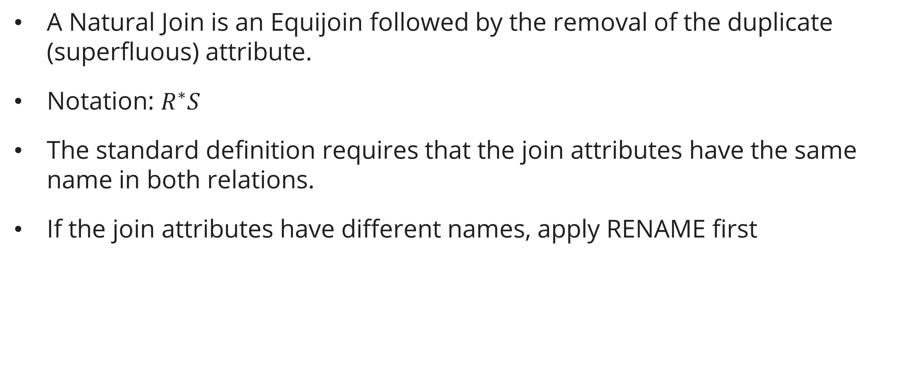
JOIN Operations
Natural Join ($∗$)
A Natural Join is an Equijoin followed by the removal of the duplicate (superfluous) attribute.
Notation: $R^{∗}S$
The standard definition requires that the join attributes have the same name in both relations.
If the join attributes have different names, apply RENAME first

Slide 19
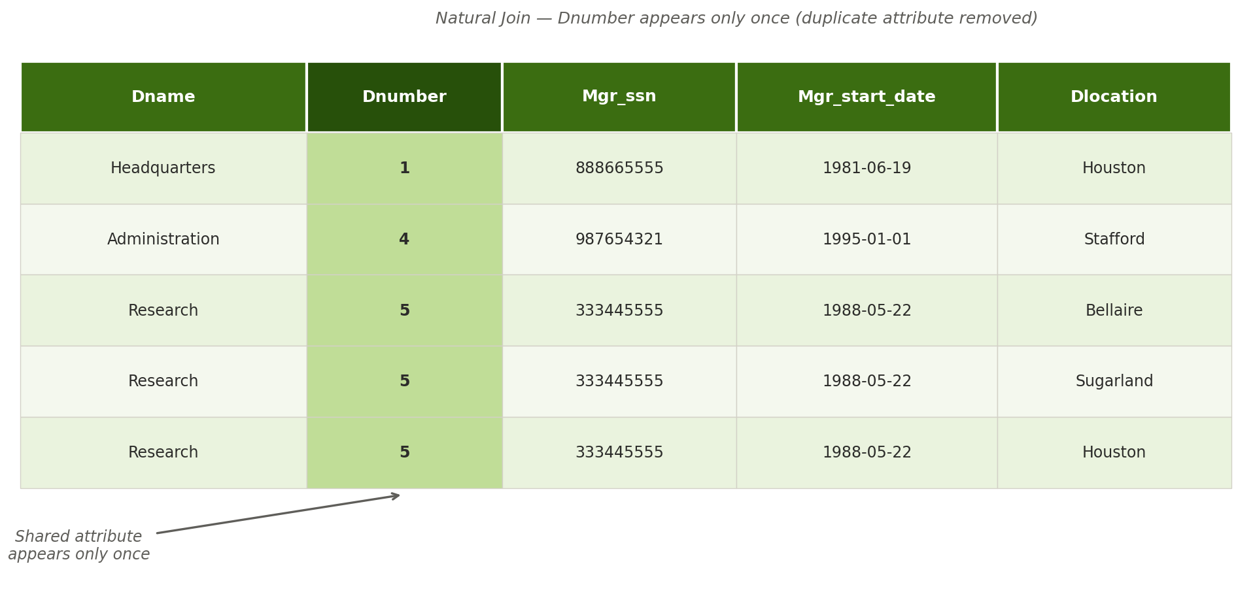

JOIN Operations
Natural Join ($∗$)
$$DEPT_LOCS\text{←}{DEPARTMENT}^{∗}DEPT_LOCATIONS$$

Slide 20
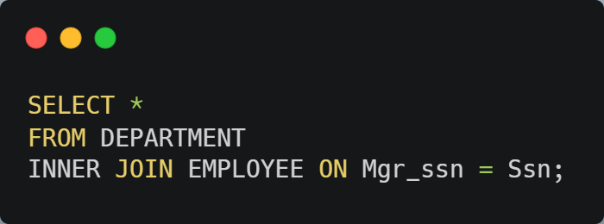
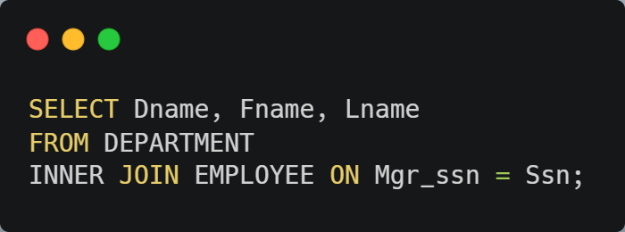
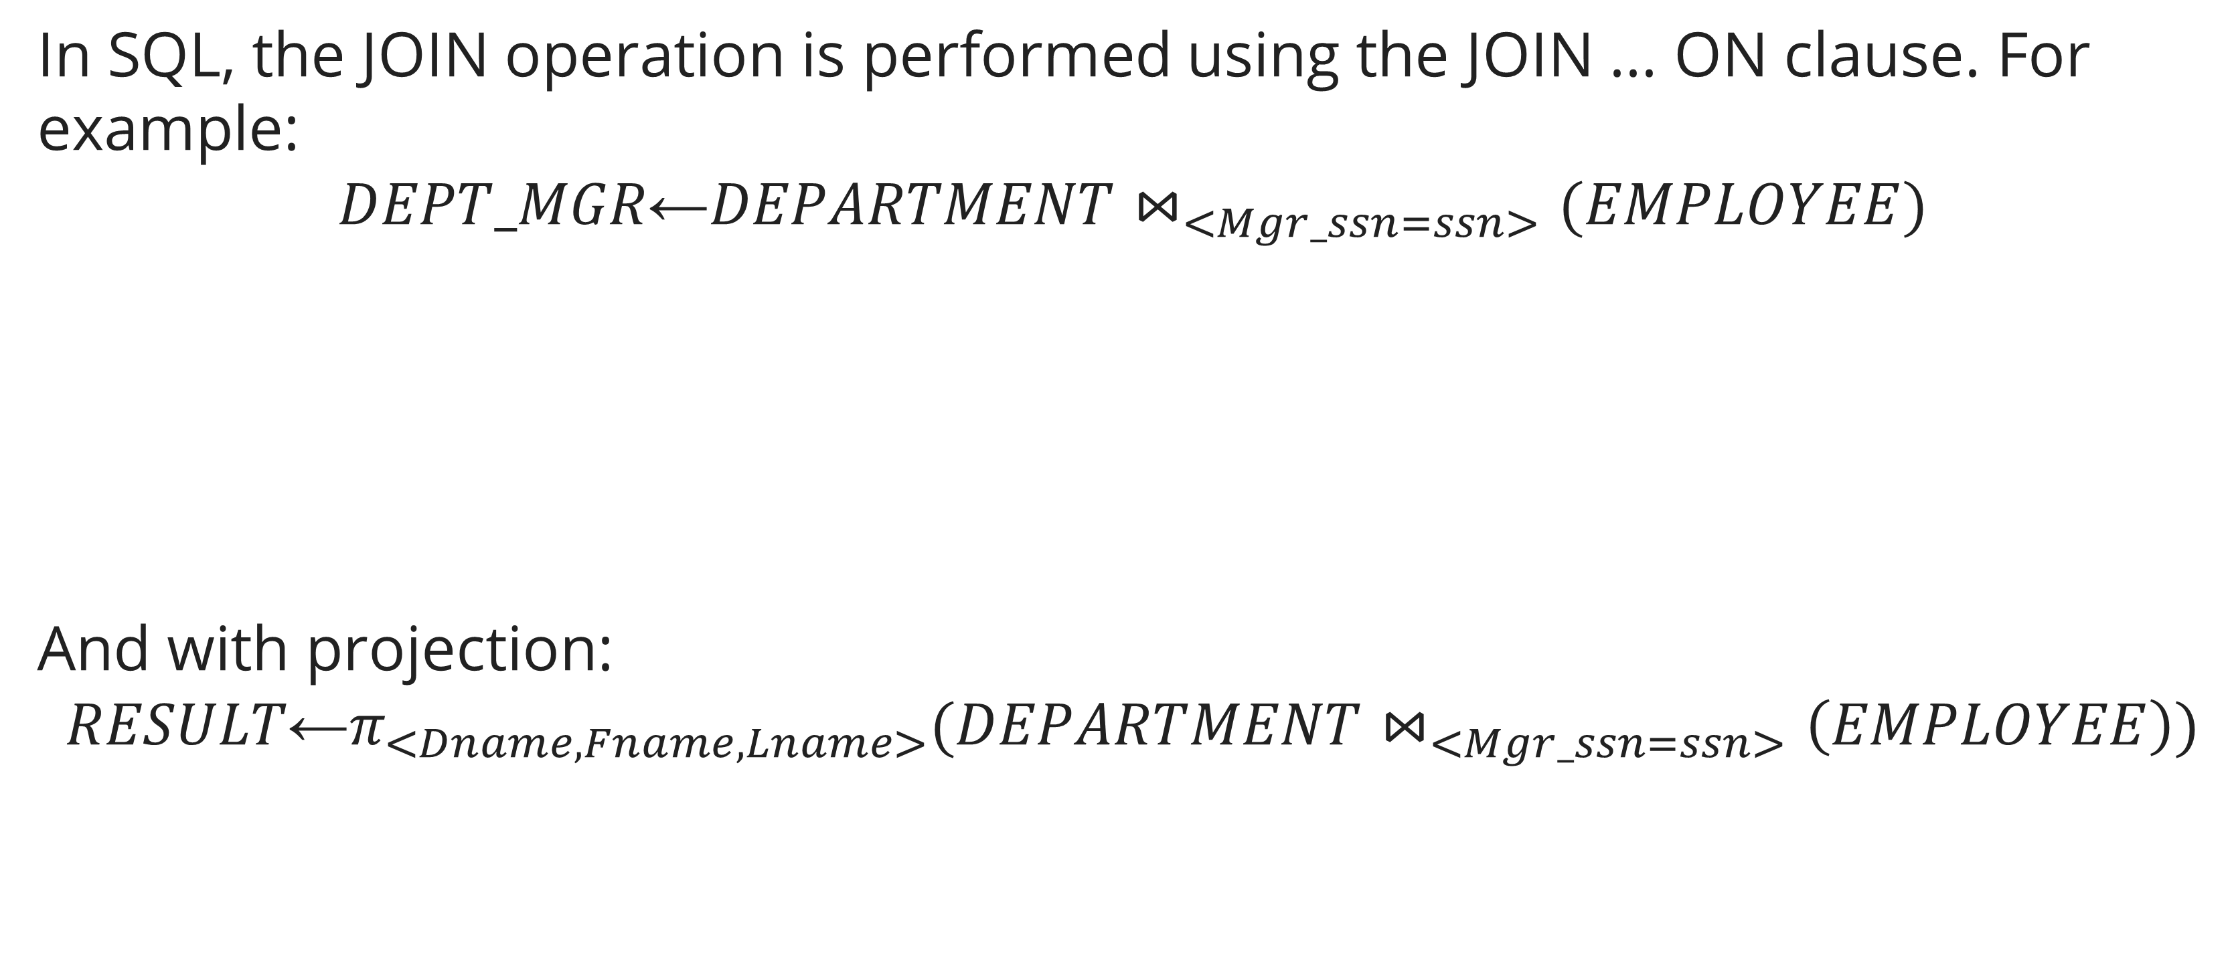
JOIN Operations
SQL Equivalent
In SQL, the JOIN operation is performed using the JOIN ... ON clause. For example:
$$DEPT_MGR\text{←}DEPARTMENT⋈_{<Mgr_ssn=ssn>}(EMPLOYEE)$$
And with projection:
$$RESULT\text{←}π_{<Dname, Fname, Lname>}(DEPARTMENT⋈_{<Mgr_ssn=ssn>}\left(EMPLOYEE\right))$$

Slide 21
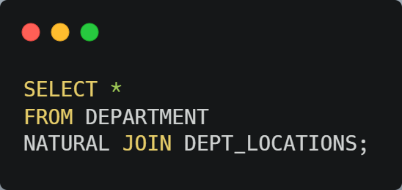

JOIN Operations
SQL Equivalent
Natural Join in SQL:
$$DEPT_LOCS\text{←}{DEPARTMENT}^{∗}DEPT_LOCATIONS$$

Slide 22
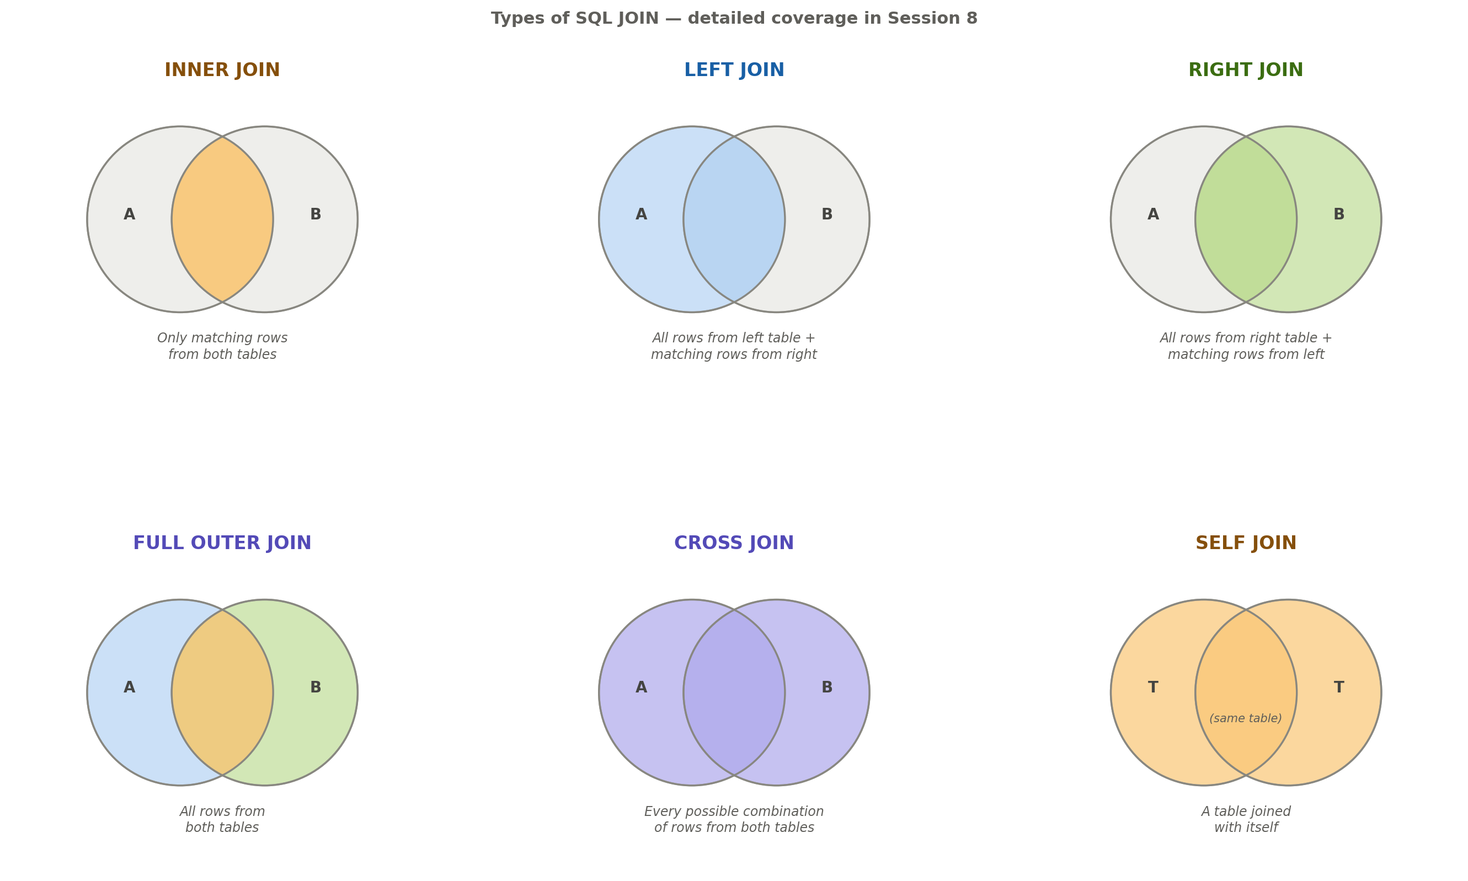
JOIN Operations
TYPES of JOIn

Slide 23
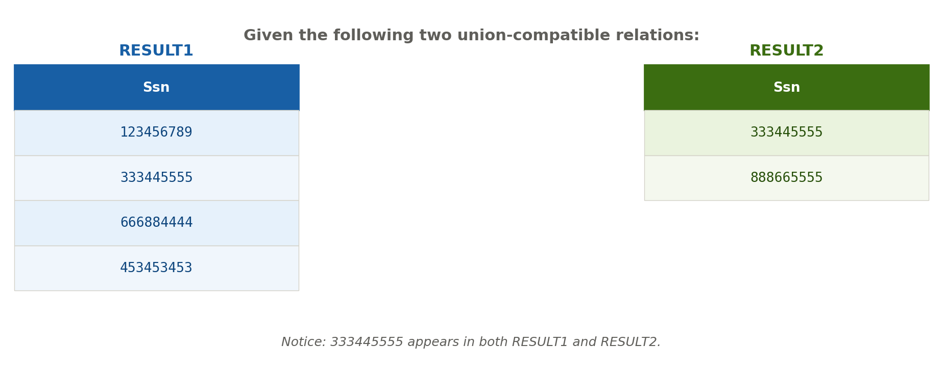
Set Operations
UNION, INTERSECTION & SET DIFFERENCE

Slide 24
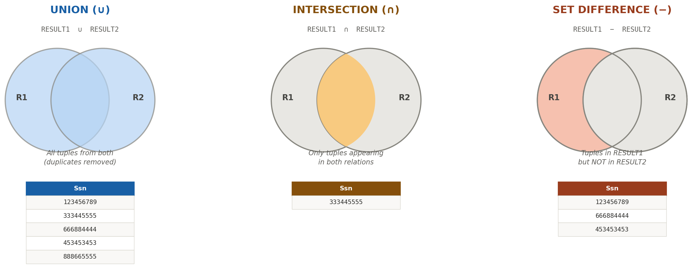
Set Operations
UNION, INTERSECTION & SET DIFFERENCE

Slide 25
Set Operations
UNION, INTERSECTION & SET DIFFERENCE
UNION: 333445555 appears only once (duplicates eliminated).
INTERSECTION: only 333445555 exists in both.
SET DIFFERENCE: removes 333445555 from RESULT1 (since it's in RESULT2).

Slide 26
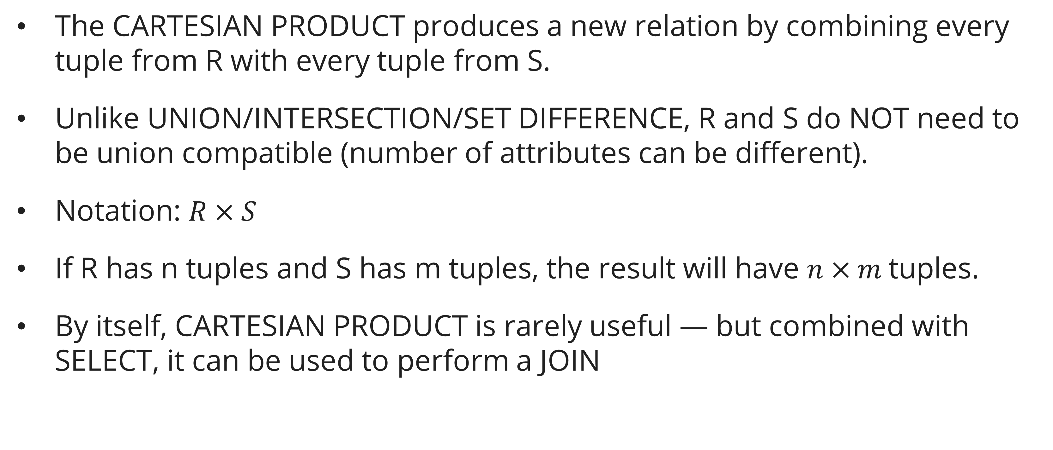
Set Operations
CARTESIAN PRODUCT ($×$)
The CARTESIAN PRODUCT produces a new relation by combining every tuple from R with every tuple from S.
Unlike UNION/INTERSECTION/SET DIFFERENCE, R and S do NOT need to be union compatible (number of attributes can be different).
Notation: $R×S$
If R has n tuples and S has m tuples, the result will have $n×m$tuples.
By itself, CARTESIAN PRODUCT is rarely useful — but combined with SELECT, it can be used to perform a JOIN

Slide 27
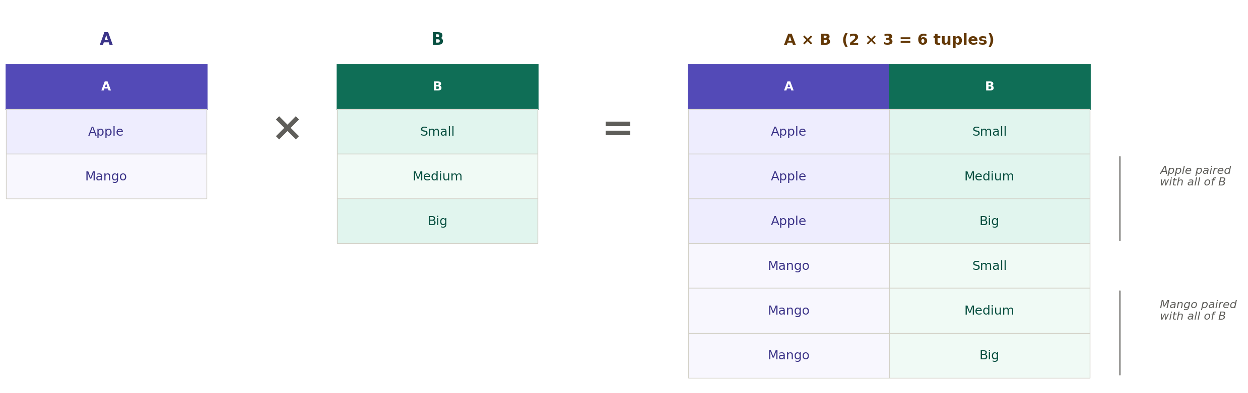
Set Operations
CARTESIAN PRODUCT ($×$)

Slide 28
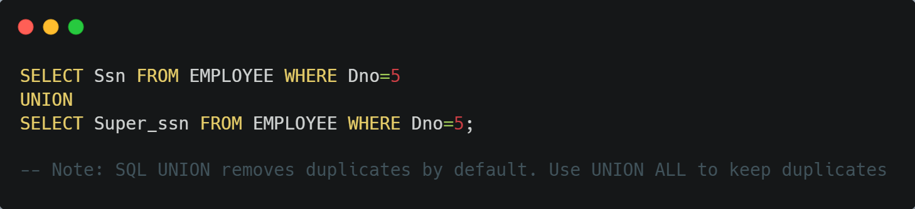
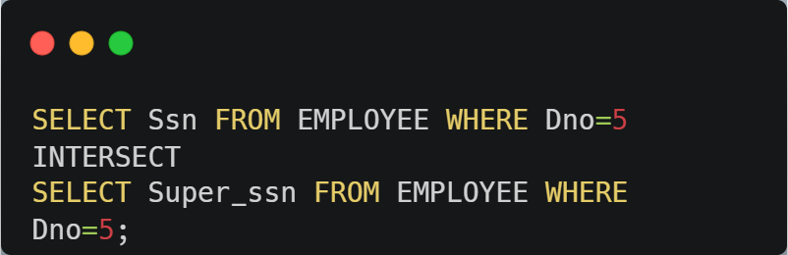

Set Operations
SQL Equivalent
Each set operation in relational algebra has a direct SQL equivalent:
UNION: $RESULT1∪RESULT2$
INTERSECTION: $RESULT1∩RESULT2$

Slide 29
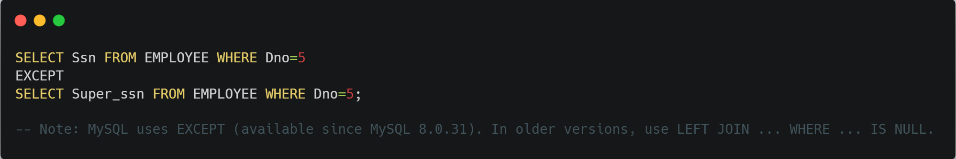


Set Operations
SQL Equivalent
Each set operation in relational algebra has a direct SQL equivalent:
SET DIFFERENCE: $RESULT1−RESULT2$
CARTESIAN PRODUCT: $RESULT1×RESULT2$

Slide 30
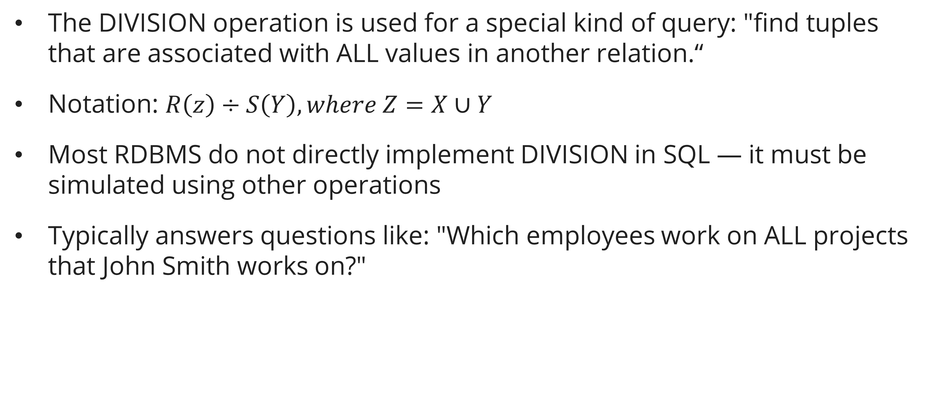
DIVISION
Concept
The DIVISION operation is used for a special kind of query: "find tuples that are associated with ALL values in another relation.“
Notation: $R\left(z\right)÷S\left(Y\right), where Z=X∪Y$
Most RDBMS do not directly implement DIVISION in SQL — it must be simulated using other operations
Typically answers questions like: "Which employees work on ALL projects that John Smith works on?"

Slide 31
DIVISION
Example
Given the following relations:
SUPPLY (Supplier, Part) — records which supplier supplies which part
ALL_PARTS (Part) — the list of all parts we need supplied
Question: "Which suppliers supply ALL the parts?"

Slide 32
DIVISION
Example
How it works:
Look at each supplier in SUPPLY.
Check if that supplier has rows for EVERY part listed in ALL_PARTS (P1, P2, P3).
If yes → include in result. If missing any → exclude.
Result: Only S1 and S4 supply all three parts.

Slide 33
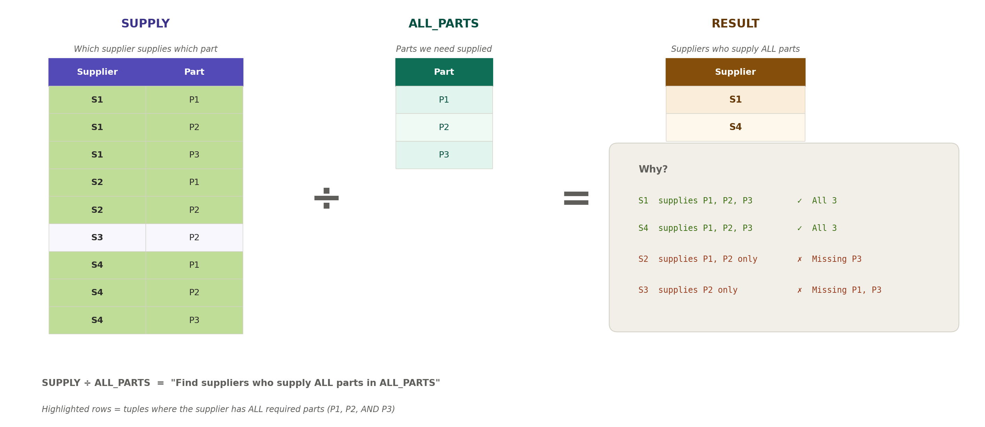
DIVISION
Example

Slide 34
Summary
Why Relational Algebra? — Relational algebra is the formal language behind SQL. The query optimizer translates SQL into relational algebra expressions to find the most efficient execution plan. Operations are divided into two groups: relational operations and set operations.
Unary Operations — SELECT (σ) filters rows by condition, equivalent to SQL WHERE. PROJECT (π) chooses specific columns and removes duplicates, equivalent to SQL SELECT DISTINCT. RENAME (ρ) renames relations or attributes. Multiple operations can be combined in sequence.
JOIN Operations — Theta Join uses any comparison operator. Equijoin uses only equality (=) and produces pairs of identical attributes. Natural Join removes the duplicate attributes automatically. SQL equivalent: INNER JOIN ... ON.
Set Operations — UNION (∪) returns all tuples from both relations. INTERSECTION (∩) returns only common tuples. SET DIFFERENCE (−) returns tuples in R but not in S. CARTESIAN PRODUCT (×) produces all possible combinations. All except × require union compatibility.
DIVISION — The DIVISION operation (÷) finds values in R that are associated with ALL values in S. It is not directly available in SQL and must be simulated. Useful for queries containing the word "ALL."

Slide 35
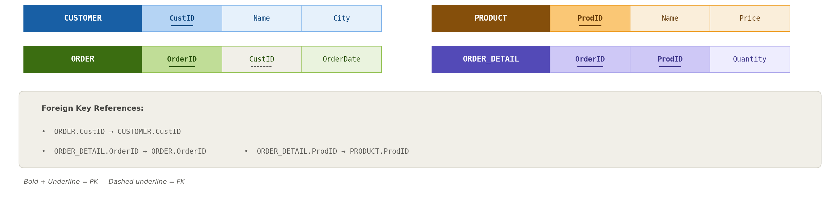
exercise

Slide 36
exercise
(RA only): Retrieve the name and price of all products that cost more than 100,000.
(RA + SQL): Retrieve the names of all customers who live in "Jakarta.“
(RA + SQL): Retrieve the OrderID and Product Names for all products in each order.
(RA only): Retrieve the names of customers who have ordered a product with a price greater than 500,000.

Slide 37
References
Session 4
Elmasri, R. & Navathe, S. (2015). Fundamentals of Database Systems, 7th Edition. Pearson. Chapter 8.

